Slide 1
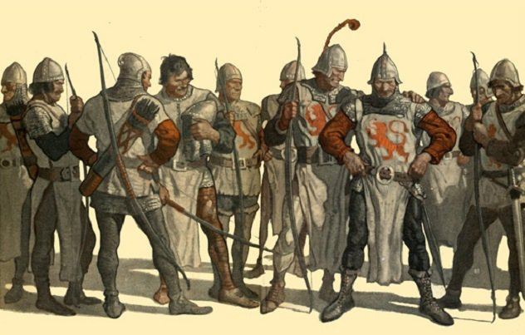
Mercenary Auction
Turtle Attack change by Chase Alexander

Slide 2
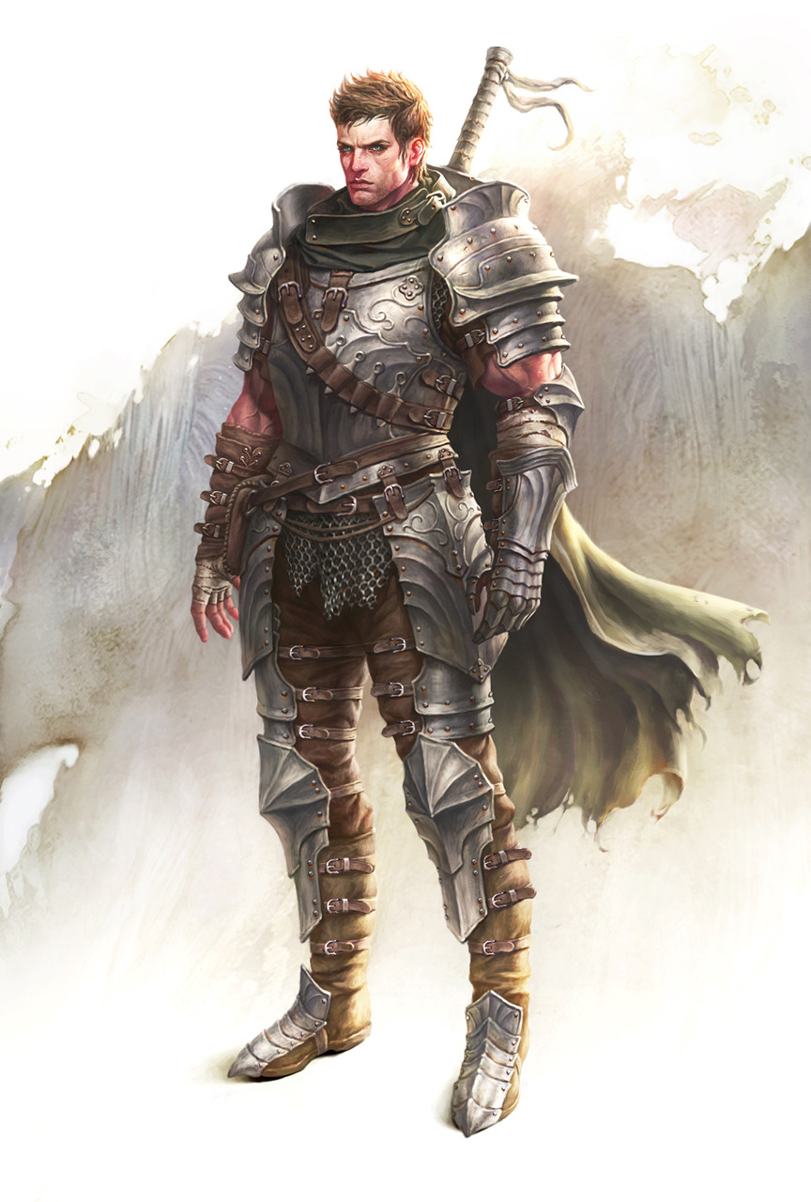
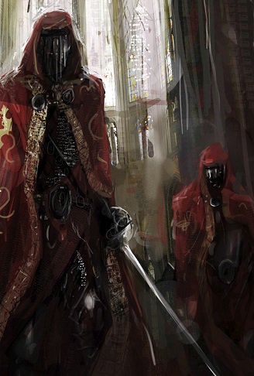
New Metaphor
Who do people attempt to bring to themselves for more power with resources?
MERCENARIES (Also paper clips are “gold” coins now)
Mercenary
Mercenary Squad
Mercenary Army
1
3
5

Slide 3
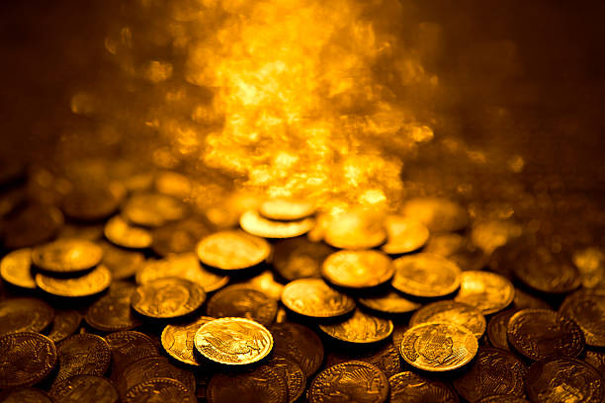
Setup
Each group (3 people) receives a deck of 15 cards (to be cut).
All players start with 15 Gold Coins
Each group will shuffle the 15-card deck and divide it into 3 stacks of 5 cards.
Place the three stacks face down.

Slide 4
Rules
Turn the first card of the first stack over
Players secretly bid for that card a number of gold coins by transferring them into their opposite hand
Bids are revealed all at once
The highest unique bid WINS the card and gets the points for their army
Mercenaries refuse to be bought for less worth than their power
If no one has enough gold for the unit they “leave” as in they don't go to anyone and the next bid starts
If there is no highest unique bid, the card is lost
Zero paperclips is not considered bidding

Slide 5
Rules Continued
9. The gold coins that were bid for each card remain on the table until the end of the stack
10. The gold coins are refreshed before players start to bid on a new stack
11. The Winner of Mercenary Auction is the player with the largest army once the third stack of cards is consumed
12. The army size corresponds to the value of the large number on each card added together for each player

Slide 6
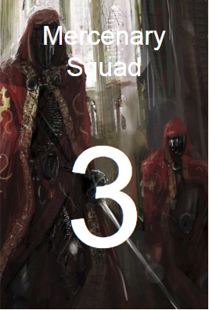
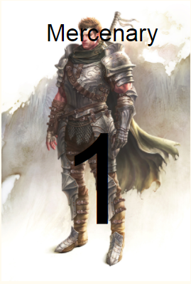
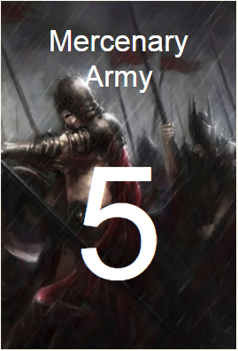

Slide 7
