Slide 1
Galaga game report
By chase alexander

Slide 2
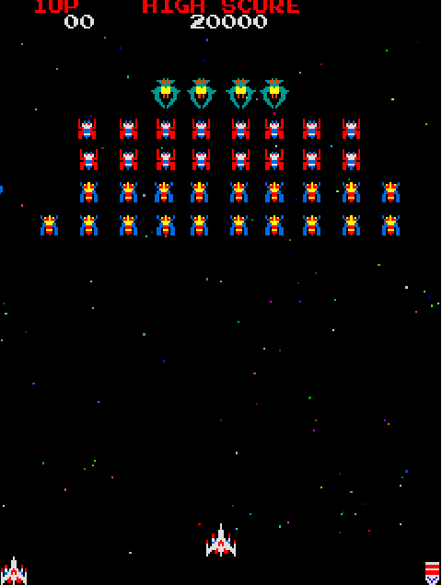
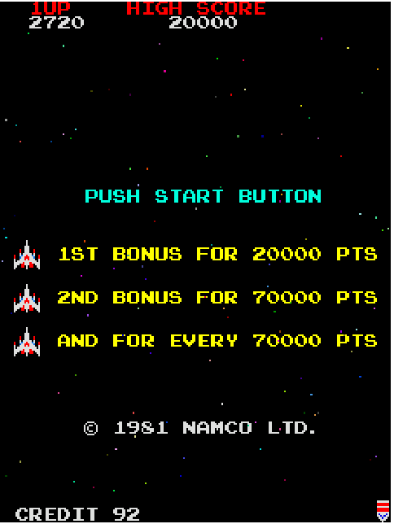
Art Style
Pixel based art style
Animated Background – Random color
Player white – Stands out
Full animations for only enemies

Slide 3
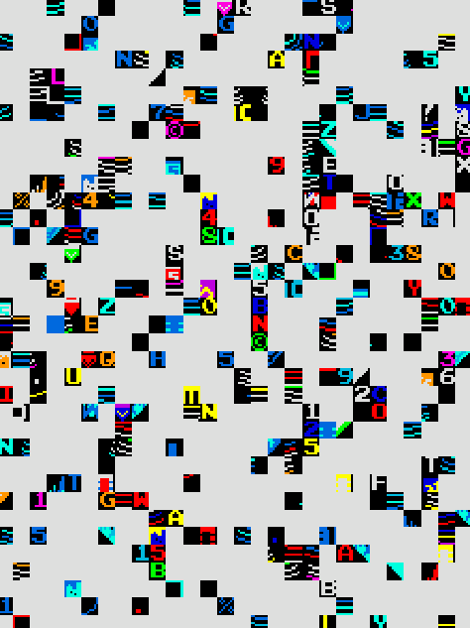
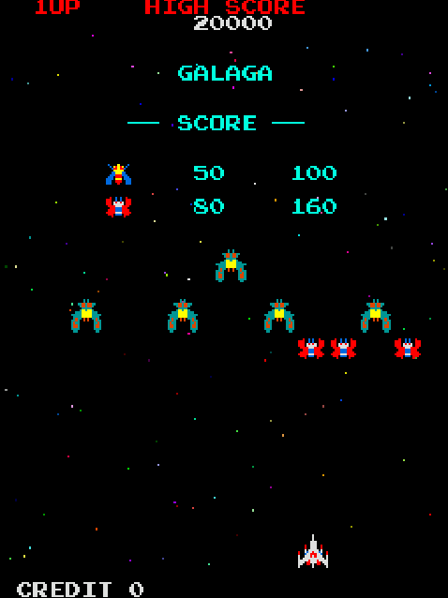
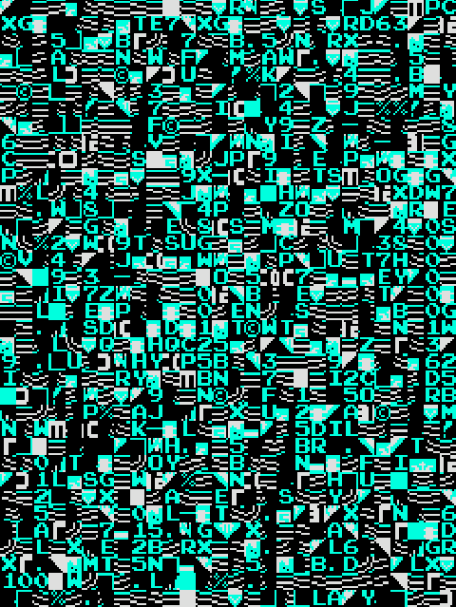
Game flow
Game starts with Static
Leading to more Static
Then to a Score screen
Then to a Game Over demo where it plays until you
enter in credits to play

Slide 4
Level Structure
Every Level is the same general set up
There are 3 tiers of enemies
The First are the Bees
Second are the Butterflies
Third are the Ships
Bonus Rounds after some levels

Slide 5
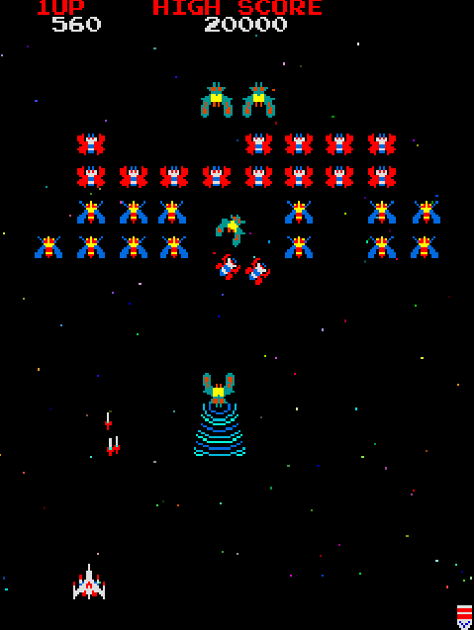
Gameplay
The player only moves left and right
The player can fire bullets to hit enemies
Enemies stay at the top until their turn to fly down and fire at you
The enemies attempt to hit you with themselves and bullets
The ships can take your ship with their beam
All enemies take one hit except ships that take two

Slide 6
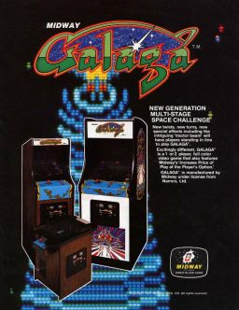
Designer/Studio
Developer: Namco
Galaga was a fairly early work for them
Some of their other Titles are:
Pac-Man
Gee Bee (Their first game)
50 different squeals of every game they make (Primarily Pac-Man)
Galaxian the prequel to Galaga

